Slide 1
Learning Objective
I will be able to apply antiderivatives to solve problems in worded context
Success Criteria
At the end of the lesson, I will be able to:
Determine displacement given velocity in linear motion problems
Determine positions given linear acceleration and initial values of position and velocity

Slide 2
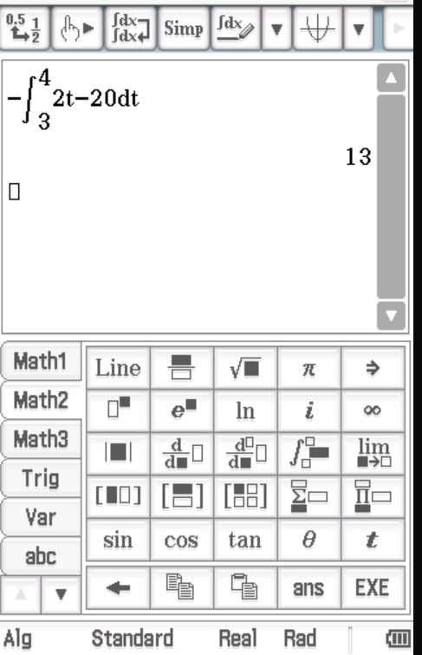

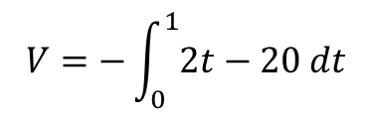
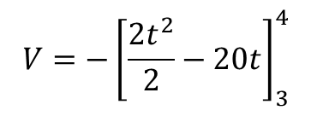

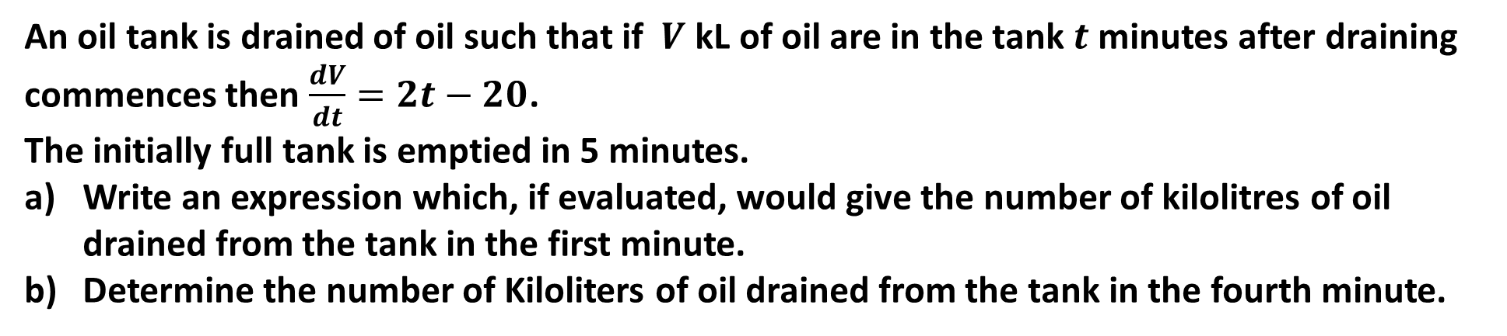
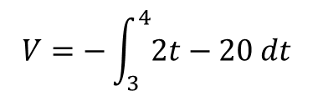


Guided Practice
An oil tank is drained of oil such that if $V$ kL of oil are in the tank $t$ minutes after draining commences then $\frac{dV}{dt}=2t−20$.
The initially full tank is emptied in 5 minutes.
Write an expression which, if evaluated, would give the number of kilolitres of oil drained from the tank in the first minute.
Determine the number of Kiloliters of oil drained from the tank in the fourth minute.
$$V=−\int_{0}^{1}{2t−20 dt}$$
$$V=−\int_{3}^{4}{2t−20 dt}$$
$$V=−{\left[\frac{2t^{2}}{2}−20t\right]}_{3}^{4}$$
$$V=−{\left[t^{2}−20t\right]}_{3}^{4}$$
$$V=−\left[4^{2}−20\left(4\right)−\left(3^{2}−20(3)\right)\right]$$
$$V=−\left[−64+51\right]=13 kL$$
$13 kL$ is drained in the fourth minute

Slide 3
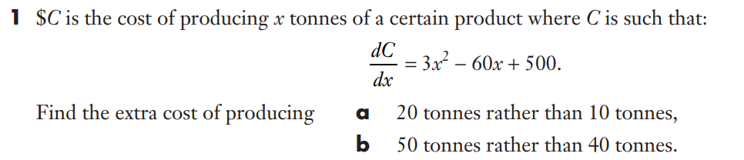
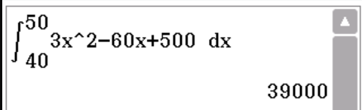
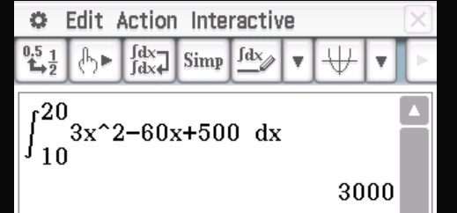
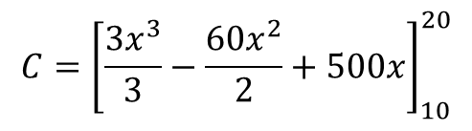


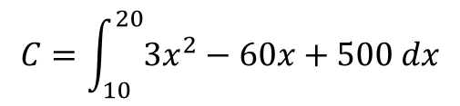


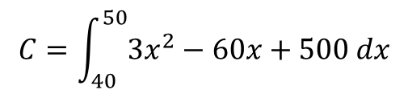
Guided Practice
$$C=\int_{10}^{20}{3x^{2}−60x+500 dx}$$
$$C=\int_{40}^{50}{3x^{2}−60x+500 dx}$$
$$C={\left[\frac{3x^{3}}{3}−\frac{60x^{2}}{2}+500x\right]}_{10}^{20}$$
$$C={\left[x^{3}−30x^{2}+500x\right]}_{40}^{50}$$
$$C={\left[x^{3}−30x^{2}+500x\right]}_{10}^{20}$$
$$C=[{20}^{3}−30{\left(20\right)}^{2}+500\left(20\right)−\left({10}^{3}−30{\left(10\right)}^{2}+500\left(10\right)\right]$$
$$C=\$39 000$$
$$C=\left(6000−3000\right)=\$3000$$

Slide 4
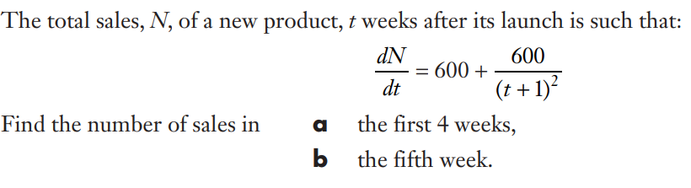
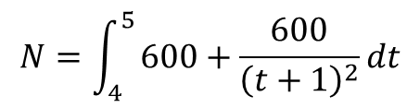
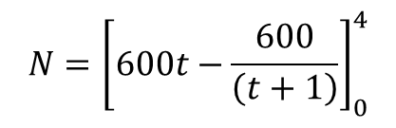
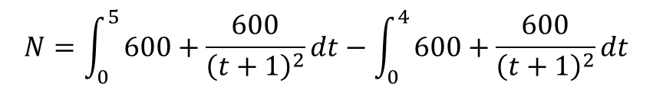
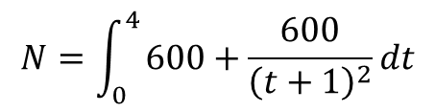


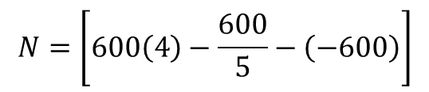
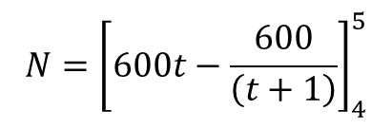
Guided Practice
$$N=\int_{0}^{4}{600+\frac{600}{{\left(t+1\right)}^{2}}dt}$$
$$N=\int_{0}^{5}{600+\frac{600}{{\left(t+1\right)}^{2}}dt}−\int_{0}^{4}{600+\frac{600}{{\left(t+1\right)}^{2}}dt}$$
$$N={\left[600t−\frac{600}{\left(t+1\right)}\right]}_{0}^{4}$$
$$N=\int_{4}^{5}{600+\frac{600}{{\left(t+1\right)}^{2}}dt}$$
$$N=\left[600\left(4\right)−\frac{600}{5}−\left(−600\right)\right]$$
$$N={\left[600t−\frac{600}{\left(t+1\right)}\right]}_{4}^{5}$$
$N=2880$ sales
$N=620$ sales

Slide 5
REVIEW: Applications of Motion
One of the most common applications of calculus that you will come across is in the study of motion.
The original function f(x) represents displacement (the vector counterpart of distance).
If we differentiate f(x), we find f’(x) which represents velocity (the vector counterpart of speed).
If we differentiate f’(x), we find f’’(x) which presents acceleration.
Vector quantities (displacement, velocity, acceleration) have direction (+ or -) and size. Scalar quantities (distance, speed) only have magnitude.
In rectilinear motion (straight line motion) if a particle moves to the right, this has POSITIVE direction. If it moves left it has NEGATIVE direction.

Slide 6
Using Integration for Applications of Motion
Now that we have covered integration and antidifferentiation, we can use this process in applied problems involving motion where we need to use acceleration to determine velocity and displacement:
Acceleration
Velocity
Displacement

Slide 7
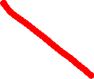

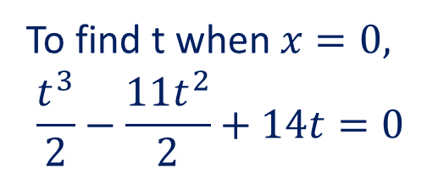
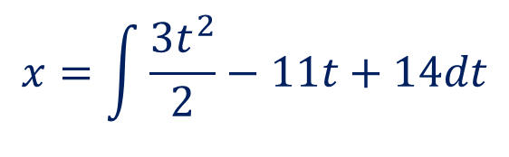



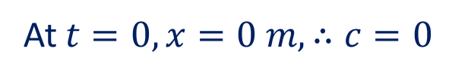
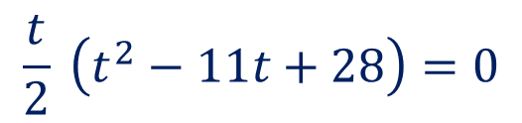
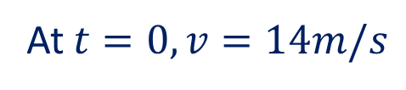
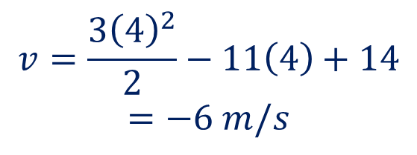

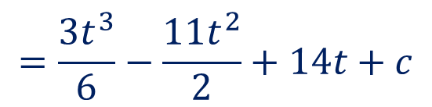
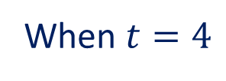
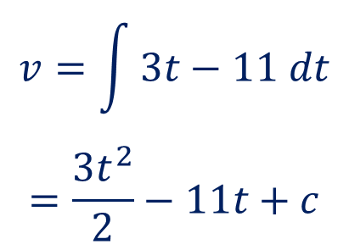

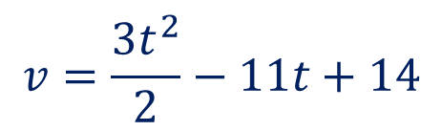
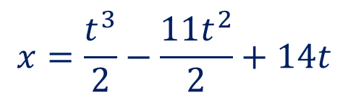


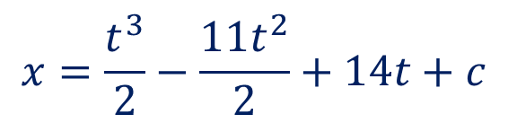
Guided Practice
A body is initially at an origin, O, and at that instant the body has a velocity of 14 m/s. The acceleration, $t$ seconds later, is $(3t−11)$m/s². Find the velocity of the body when it is next at O.
$$a=3t−11$$
$$x=\frac{t^{3}}{2}−\frac{11t^{2}}{2}+14t+c$$
$$v=\int{3t−11 dt}$$
$$=\frac{3t^{2}}{2}−11t+c$$
$$t=0, t=4, t=7$$
(reject)
(reject)
At $t=0,x=0 m, ∴c=0$
$$x=\frac{t^{3}}{2}−\frac{11t^{2}}{2}+14t$$
At $t=0, v=14m/s$
When $t=4$
$$∴c=14$$
$$v=\frac{3t^{2}}{2}−11t+14$$
To find t when $x=0,$
$$\frac{t^{3}}{2}−\frac{11t^{2}}{2}+14t=0$$
$$v=\frac{3{\left(4\right)}^{2}}{2}−11\left(4\right)+14$$
$$=−6 m/s$$
$$x=\int{\frac{3t^{2}}{2}−11t+14dt}$$
$$\frac{t}{2} \left(t^{2}−11t+28\right)=0$$
$$=\frac{3t^{3}}{6}−\frac{11t^{2}}{2}+14t+c$$
$$t\left(t−4\right)\left(t−7\right)=0$$

Slide 8




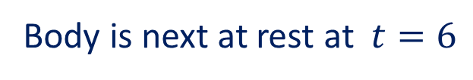
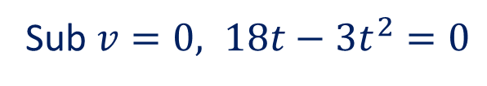





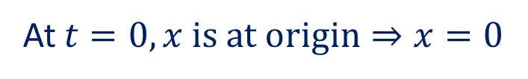


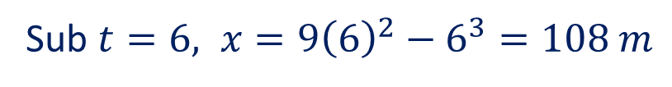

Guided Practice
A body is initially at rest at an origin, O, and moves in a straight line such that its acceleration, $t$ seconds later, is $\left(18 – 6t\right)$ m/s².
The value of $t$ when the body is next at rest and the displacement at this time.
The distance the body moves from $t=5$ to $t=7$
$$x=\int{18t−3t^{2}dt}$$
$$=\frac{18t^{2}}{2}−\frac{3t^{3}}{3}+c$$
$$a=18−6t$$
$$v=\int{18−6t dt}$$
$$=18t−\frac{6t^{2}}{2}+c$$
Sub $v=0, 18t−3t^{2}=0$
$$3t(6−t)=0$$
$$t=0 , t=6$$
Body is next at rest at $t=6$
$$x=9t^{2}−t^{3}+c$$
At $t=0, x is at origin⇒x=0$
$$v=18t−3t^{2}+c$$
At $t=0, v is at rest⇒v=0 m/s$
$$x=9t^{2}−t^{3}$$
$$∴c=0$$
Sub $t=6, x=9{\left(6\right)}^{2}−6^{3}=108 m$
$$v=18t−3t^{2}$$

Slide 9
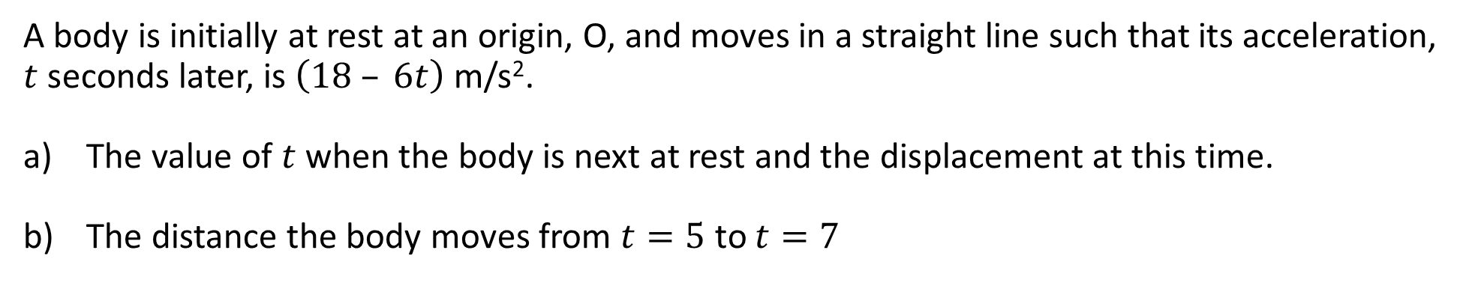
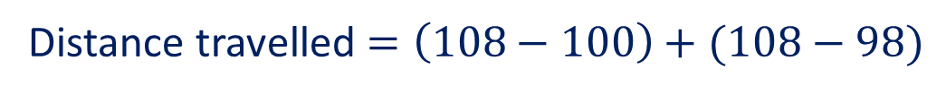
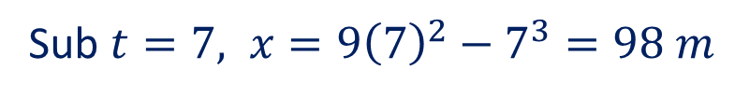
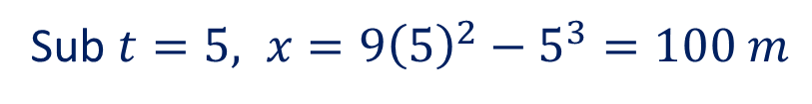


Guided Practice
A body is initially at rest at an origin, O, and moves in a straight line such that its acceleration, $t$ seconds later, is $\left(18 – 6t\right)$ m/s².
The value of $t$ when the body is next at rest and the displacement at this time.
The distance the body moves from $t=5$ to $t=7$
$$x=9t^{2}−t^{3}$$
Sub $t=5, x=9{\left(5\right)}^{2}−5^{3}=100 m$
Distance travelled $=\left(108−100\right)+(108−98)$
Sub $t=7, x=9{\left(7\right)}^{2}−7^{3}=98 m$
$$=18 m$$

Slide 10
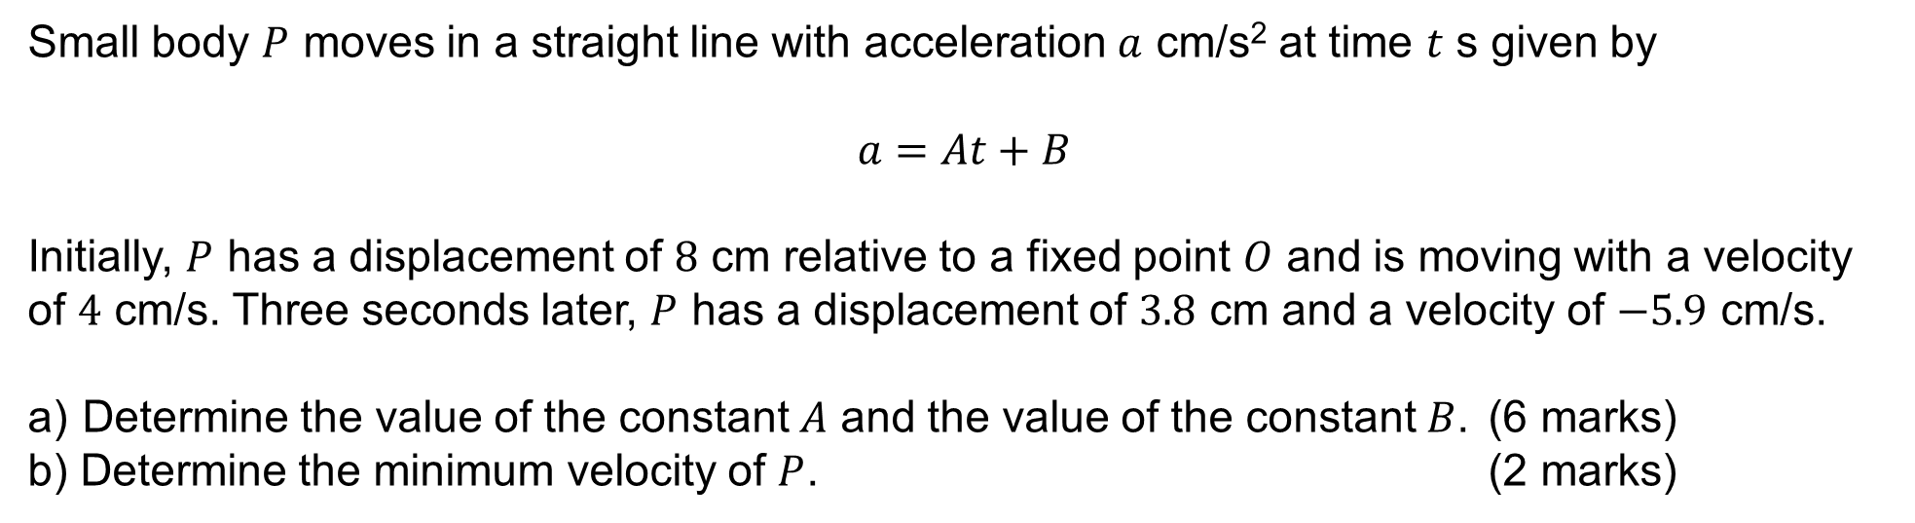
ATAR Exam 2021 Calc-Assumed (8 marks)
Small body $P$ moves in a straight line with acceleration $a$ cm/s² at time $t$ s given by
$$a=At+B$$
Initially, $P$ has a displacement of $8$ cm relative to a fixed point $O$ and is moving with a velocity of $4$ cm/s. Three seconds later, $P$ has a displacement of $3.8$ cm and a velocity of $−5.9$ cm/s.
Determine the value of the constant $A$ and the value of the constant $B$. (6 marks)
b) Determine the minimum velocity of $P$. (2 marks)

Slide 11
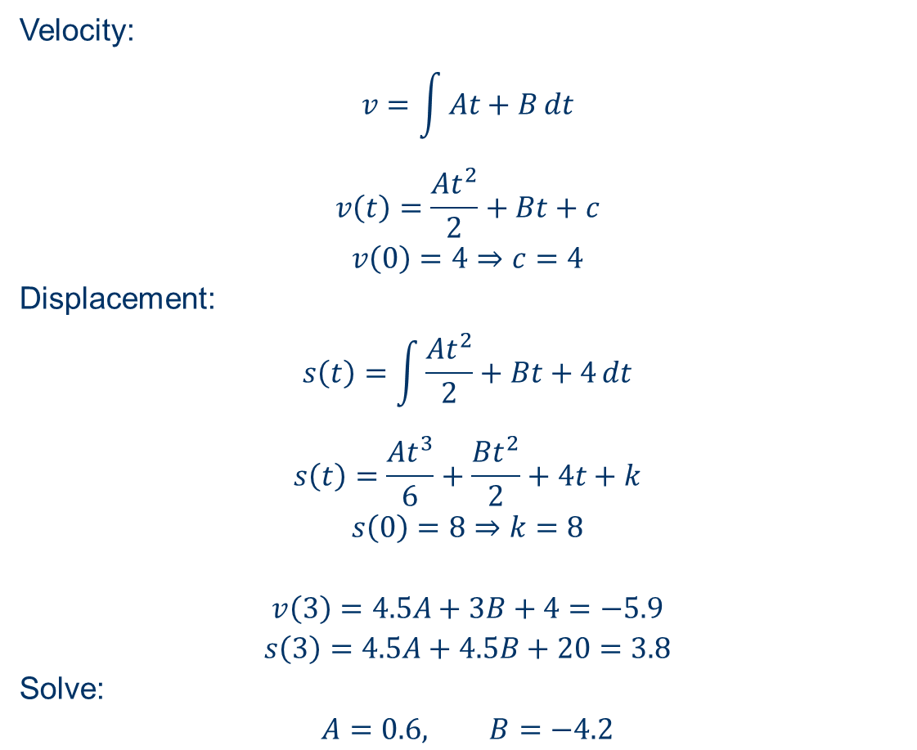
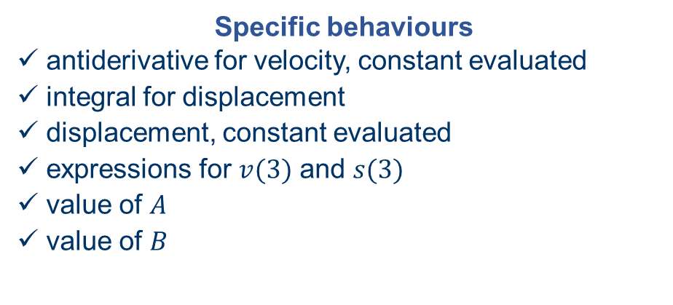
ATAR Exam 2021 Calc-Assumed (8 marks)
Determine the value of the constant $A$ and the value of the constant $B$. (6 marks)
Velocity:
$$v=\int{At+B}dt$$
$$v\left(t\right)=\frac{At^{2}}{2}+Bt+c$$
$$v\left(0\right)=4⇒c=4$$
Displacement:
$$s\left(t\right)=\int{\frac{At^{2}}{2}+Bt+4}dt$$
$$s\left(t\right)=\frac{At^{3}}{6}+\frac{Bt^{2}}{2}+4t+k$$
$$s\left(0\right)=8⇒k=8$$
$$v\left(3\right)=4.5A+3B+4=−5.9$$
$$s\left(3\right)=4.5A+4.5B+20=3.8$$
Solve:
$$A=0.6, B=−4.2$$
Specific behaviours
ü antiderivative for velocity, constant evaluated
ü integral for displacement
ü displacement, constant evaluated
ü expressions for $v(3)$ and $s(3)$
ü value of $A$
ü value of $B$

Slide 12
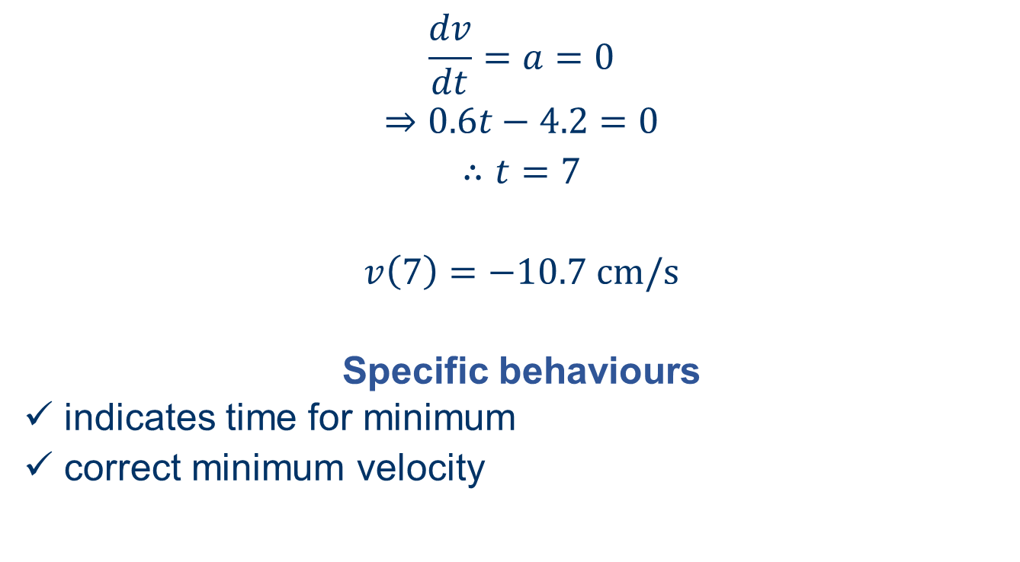
ATAR Exam 2021 Calc-Assumed (8 marks)
b) Determine the minimum velocity of $P$. (2 marks)
$$\frac{dv}{dt}=a=0$$
$$⇒0.6t−4.2=0$$
$$∴t=7$$
$$v\left(7\right)=−10.7 \text{cm}\text{/}\text{s}$$
Specific behaviours
✓ indicates time for minimum
ü correct minimum velocity

Slide 13
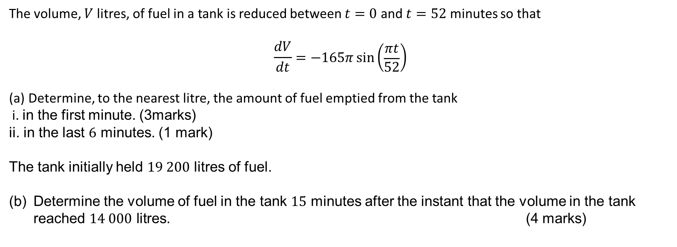
ATAR Exam 2021 Calc-Assumed (8 marks)
The volume, $V$ litres, of fuel in a tank is reduced between $t=0$ and $t=52$ minutes so that
$$\frac{dV}{dt}=−165π\sin\left(\begin{matrix}πt \\ \overline{52}\end{matrix}\right)$$
Determine, to the nearest litre, the amount of fuel emptied from the tank
i. in the first minute. (3marks)
ii. in the last $6$ minutes. (1 mark)
The tank initially held $19 200$ litres of fuel.
(b) Determine the volume of fuel in the tank $15$ minutes after the instant that the volume in the tank reached $14 000$ litres. (4 marks)

Slide 14
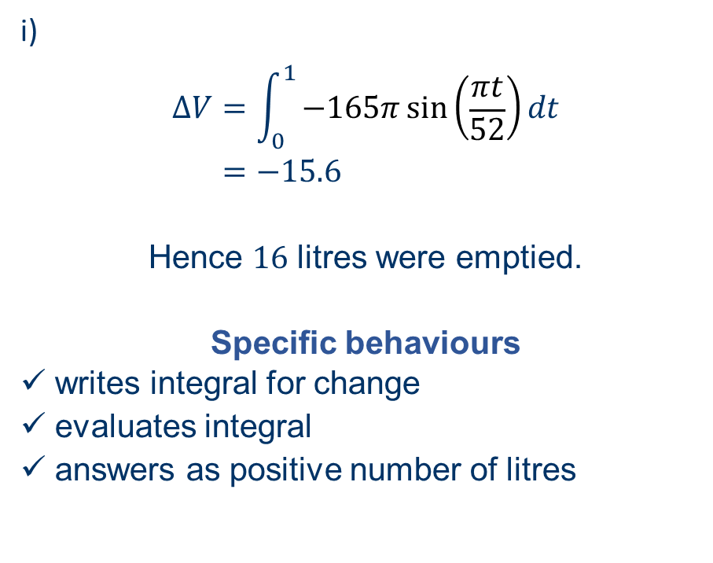
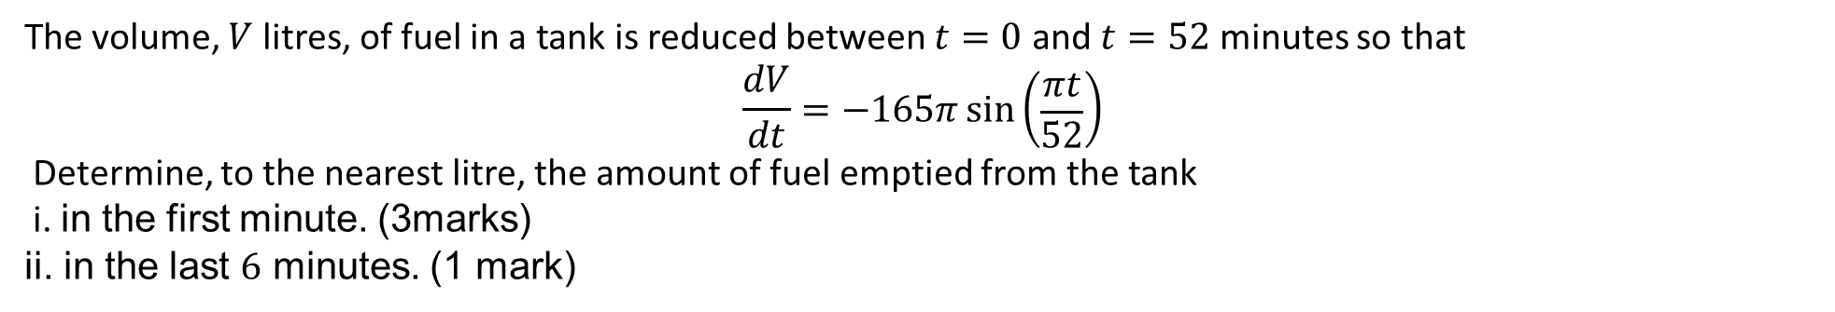
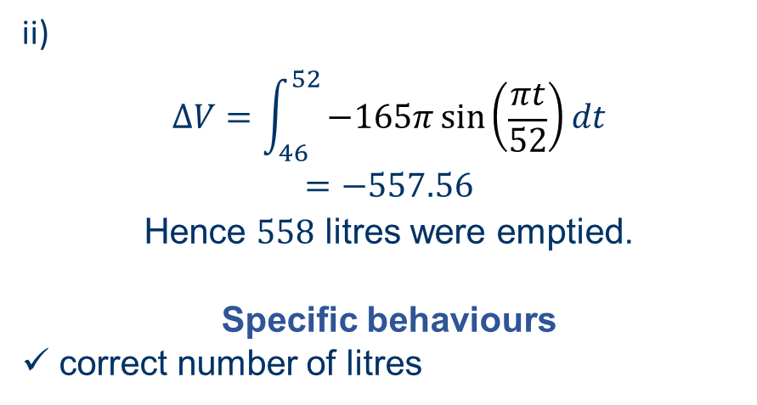
ATAR Exam 2021 Calc-Assumed (8 marks)
The volume, $V$ litres, of fuel in a tank is reduced between $t=0$ and $t=52$ minutes so that
$$\frac{dV}{dt}=−165π\sin\left(\begin{matrix}πt \\ \overline{52}\end{matrix}\right)$$
Determine, to the nearest litre, the amount of fuel emptied from the tank
i. in the first minute. (3marks)
ii. in the last $6$ minutes. (1 mark)
i)
$$∆V=\int_{0}^{1}{−165π\sin\left(\begin{matrix}πt \\ \overline{52}\end{matrix}\right)}dt \\ =−15.6$$
Hence $16$ litres were emptied.
Specific behaviours
✓ writes integral for change
ü evaluates integral
ü answers as positive number of litres
ii)
$$ΔV=\int_{46}^{52}{−165π\sin\left(\begin{matrix}πt \\ \overline{52}\end{matrix}\right)}dt$$
$$=−557.56$$
Hence $558$ litres were emptied.
Specific behaviours
ü correct number of litres

Slide 15



ATAR Exam 2021 Calc-Assumed (8 marks)
The volume, $V$ litres, of fuel in a tank is reduced between $t=0$ and $t=52$ minutes so that
$$\frac{dV}{dt}=−165π\sin\left(\begin{matrix}πt \\ \overline{52}\end{matrix}\right)$$
The tank initially held $19 200$ litres of fuel.
(b) Determine the volume of fuel in the tank $15$ minutes after the instant that the volume in the tank reached $14 000$ litres. (4 marks)
$$V\left(t\right)=\int_{ }^{ }{−165π\sin\left(\begin{matrix}πt \\ \overline{52}\end{matrix}\right)}dt$$
$$=8060\cos\left(\frac{πt}{52}\right)+c$$
$$V\left(0\right)=19 200⇒c=11 140$$
$$V\left(t\right)=8060\cos\left(\frac{πt}{52}\right)+11 140$$
$$V\left(T\right)=14 000, 8060\cos\left(\frac{πt}{52}\right)+11 140=14000$$
$$⇒T=19.996$$
$$V\left(35\right)=6 972 \text{L}$$
Specific behaviours
✓ antiderivative for $V\left(t\right)$
ü determines $c$
ü determines $T$
ü correct volume

Slide 16
Independent Practice
Complete Cambridge Ex 6J

